Slide 1
The State of Infant and Toddler Care
www.zerotothree.org
Copyright © 2015 ZERO TO THREE. All rights reserved.

Slide 2

About ZERO TO THREE
Our mission is to ensure that all babies and toddlers have a strong start in life.
We provide parents, professionals, and policymakers the knowledge and know-how to nurture early development.
We envision a society with the knowledge and the will to support all infants and toddlers in reaching their full potential.
Copyright © 2015 ZERO TO THREE. All rights reserved.

Slide 3


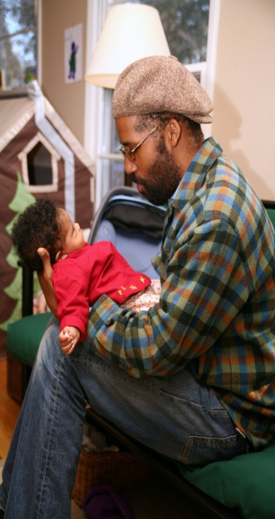
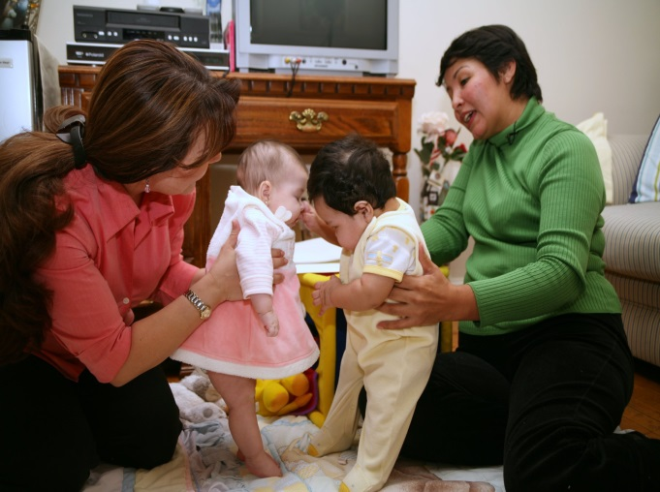
Infants and Toddlers
Notes:
There are approximately 2 million infants and toddlers in California…..

Slide 4

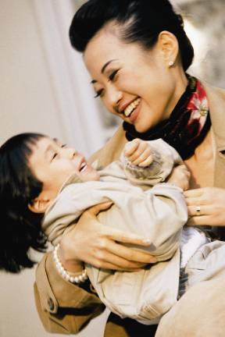
The Early Years Matter
How children feel is as important as how they think, and how they are treated is as important as what they are taught, particularly with respect to their readiness to succeed in school.

Slide 5
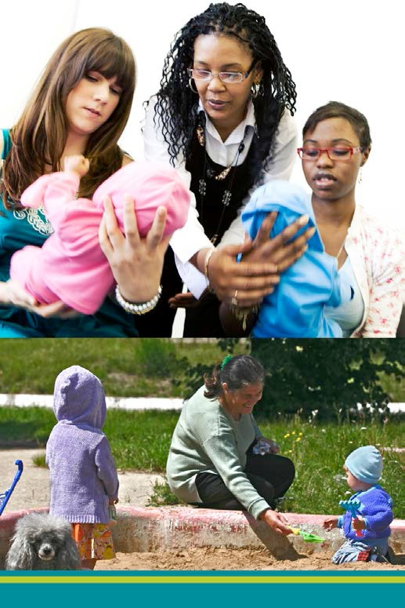
Babies Are Small. Their Needs Are Big.
Parents and caregivers need resources and tools to provide a safe, loving, and nurturing environment for babies and young children.
No one profession or sector contains the expertise or resources to recognize and meet babies and young children’s needs.
Notes:
Parents and very young children need access to support services, including parent education, adequate nutrition, high quality early care and education, and preventive health programs. These services not only benefit young children and families but are also sound investments for California’s growing economy.

Slide 6

What can we do?
Build bridges and break down silos that create barriers for professionals and parents.
Copyright © 2015 ZERO TO THREE. All rights reserved.

Slide 7
Cross Sector Approach
Allows professionals to develop a multi-dimensional view of children and families
Provides opportunities to engage in effective services
Builds powerful partnerships between professionals and with parents
Enhances collaboration strengthen families and promote child well-being
Copyright © 2015 ZERO TO THREE. All rights reserved.

Slide 8
Collaboration
Collaboration is a key component of cross-sector work.
Involves sharing resources
Occurs among multidisciplinary professionals
Occurs between professionals and parents
Copyright © 2015 ZERO TO THREE. All rights reserved.

Slide 9
Recognize the powerful impact of relationships on relationships.

Slide 10
Teresa: a young child age 20 months

Slide 11

Questions?

Slide 12

Contact Information
Tahra Goraya, M.A.
Director, Western Office
TGoraya@zerotothree.org
Christina Nigrelli, M.A. Ed.S.
Senior Director of Programs, Western Office
CNigrelli@zerotothree.org

Slide 13
Resources
Cross-Sector Approach
“Findings of a Cross-Sector Core Competencies Project: Supporting a Workforce for Infants, Toddlers and Their Families” http://www.zerotothree.org/wo/assets/docs/ztt_summit6pagebrochure_fnlreadonlynew.pdf
“Collaborative Partnerships Between Early Care & Education and Child Welfare: Supporting Infants, Toddlers, and Their Families Through Risk to Resilience” http://www.zerotothree.org/public-policy/state-community-policy/nitcci/collaborative-partnerships-between-ece.pdf
“Infants and Toddlers in the Policy Picture: A Self-Assessment Checklist for States” http://www.zerotothree.org/public-policy/policy-toolkit/checklistsinglesmar5.pdf
“The Big Picture Planning Guide: Building Cross-Sector Professional Development Systems in Early Childhood” http://fpg.unc.edu/sites/fpg.unc.edu/files/resources/reports-and-policy-briefs/FPG_NPDCI_Big-Picture-Planning-Guide_2011.pdf

Slide 14
Resources
Poverty
“State Baby Facts: California” http://www.zerotothree.org/public-policy/state-community-policy/baby-facts/california-baby-facts.pdf
“Getting Back to Basics: Building the Foundation for Infants, Toddlers, and Families” http://zerotothree.org/public-policy/policy-toolkit/basicneedssingles_mar5.pdf
Working Families Infographic http://www.zerotothree.org/public-policy/working-families-infographic.html
Beyond the Word Gap: Multimedia Resources and Tools http://www.zerotothree.org/policy/beyond-the-word-gap/
“Children’s Defense Fund Child Poverty in America 2013: National Analysis” http://www.childrensdefense.org/zzz-child-research-data-publications/child-poverty-in-america-2013.pdf
“The State of America’s Children 2014” http://www.childrensdefense.org/library/state-of-americas-children/2014-soac.pdf

Slide 15
Resources
Impact of Trauma
“Securing a Bright Future: Maltreated Infants and Toddlers” http://www.zerotothree.org/public-policy/policy-toolkit/childwelfareforweboct21.pdf
“Safe Babies Court Teams: Building Strong Families and Healthy Communities” http://www.zerotothree.org/maltreatment/safe-babies-court-team/safe-babies-court-teams-building-strong-families-and-healthy-communities.html
“Building Resilience: The Power to Cope with Adversity” http://www.zerotothree.org/maltreatment/31-1-prac-tips-beardslee.pdf
“A Call to Action on Behalf of Maltreated Infants and Toddlers” http://www.childrensdefense.org/library/data/call-to-action-on-behalf-of-maltreated-infants-and-toddlers.pdf

